Slide 1
Two Photon Corrections to the Proton Form Factor Ratio
Tyler Hague

Slide 2
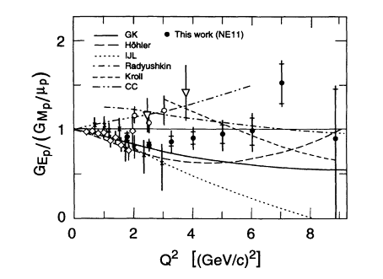
μG_{E}/G_{M} from Rosenbluth Separation (1994)
Source: L. Andivahis et al., Phys. Rev. D 50, 9 (1994)

Slide 3
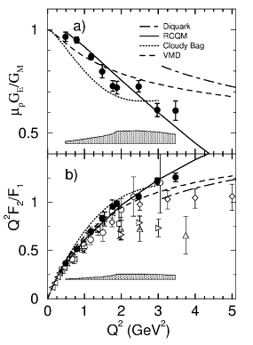
μG_{E}/G_{M} from Polarization Transfer(2000)
Source: M. K. Jones et al. Phys. Rev. Lett. 84 7 (2000)

Slide 4
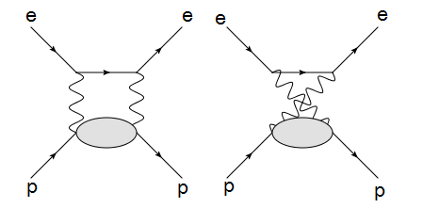
Two Photon Exchange Diagrams
Corrections Included in:
L. W. Mo, Y. S. Tsai, Rev. of Mod. Phys. 41 1

Slide 5
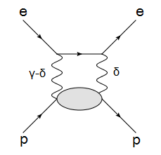
The Momentum Transfer Integral
Source: L. C. Maximon, J. A. Tjon, Phys. Rev. C 62 054320

Slide 6
A Pseudo-Data Example at Q²=10(GeV/c)²

Slide 7
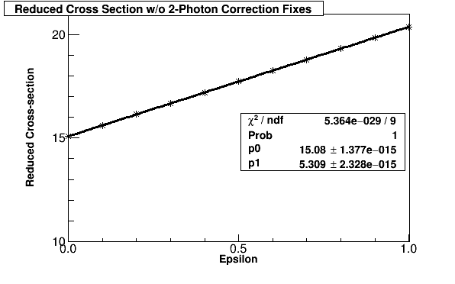
A Pseudo-Data Example at Q²=10(GeV/c)²

Slide 8
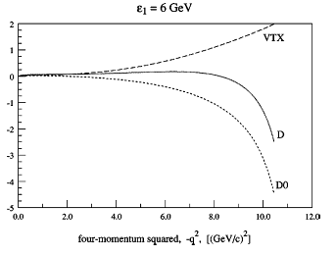
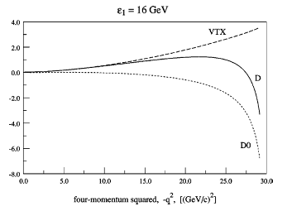
The Corrections
Percentage change to the cross section as a function of beam energy and Q²
Source: L. C. Maximon, J. A. Tjon, Phys. Rev. C 62 054320

Slide 9
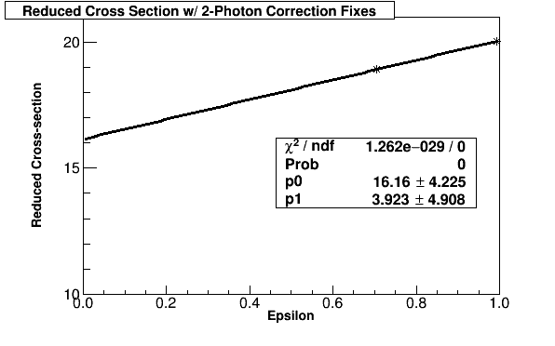
A Pseudo-Data Example at Q²=10(GeV/c)²
Corrections from:
L. C. Maximon, J. A. Tjon, Phys. Rev. C 62 054320

Slide 10
Future Improvements
Off-Shell Proton must be accounted for

Slide 11
Conclusions
The polarization transfer measurement of the proton form factor ratio led to a closer look at radiative corrections
The two photon exchange diagrams were included from the beginning, but were treated with a poor approximation
Work to improve the calculation of the two photon exchange diagrams is underway and is reducing the discrepancy between the two measurements

